Slide 1

UNIVERSITY INSTITUTE ENGINEERING
DEPARTMENT OF COMPUTER SCIENCE & ENGINEERING
Bachelor of Engineering
Submitted By: Chandrashekhar Yash Sanskriti
Tanuja
DISCOVER . LEARN . EMPOWER

Slide 2


Slide 3


Slide 4


Slide 5


Slide 6


Slide 7


Slide 8


Slide 9
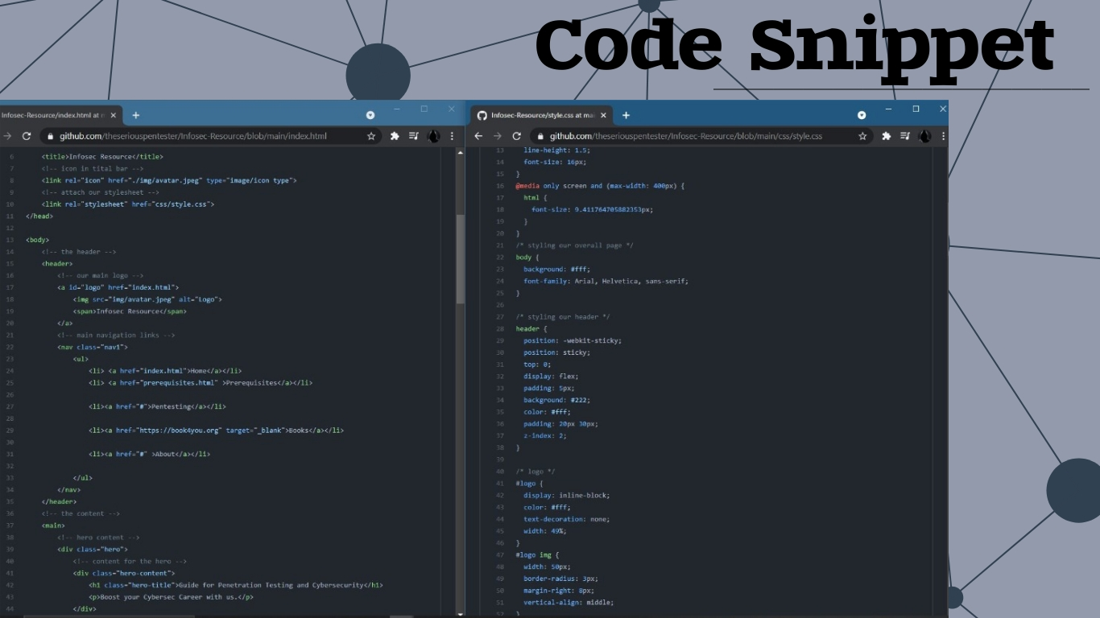

Slide 10


Slide 11


